Slide 1
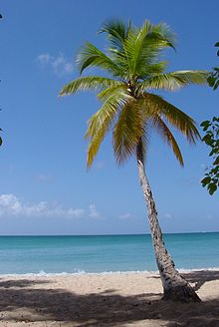

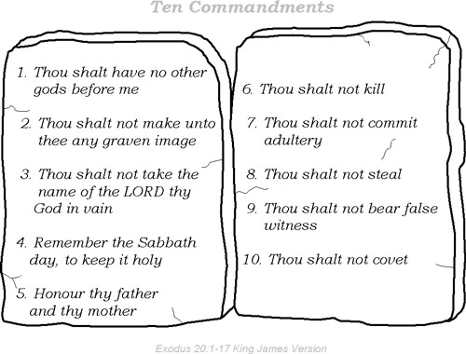
Invent your own Island
Draw a map of your island.
Design your own flag.
3. Decide on rules for your island.
4. Give reasons why you would make a good leader on this island.

